Slide 1



主动学习及其应用初探
黄圣君
huangsj@nuaa.edu.cn
http://parnec.nuaa.edu.cn/huangsj
2019-12-20

Slide 2
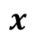
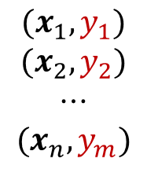
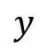
A Typical Setting of Supervised Learning
$$x$$
unseen data
$$(x_{1},y_{1})$$
$$(x_{2},y_{2})$$
$$⋯$$
$$(x_{n},y_{m})$$
training
model
labeled
training data
$$y$$
label

Slide 3
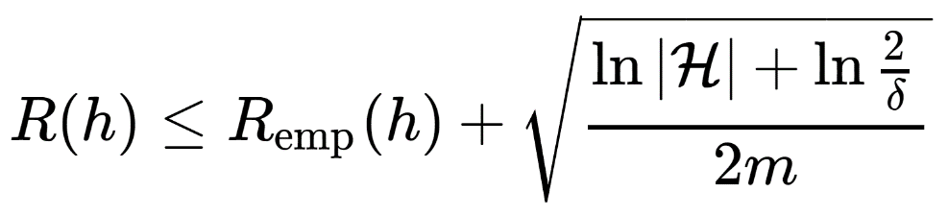
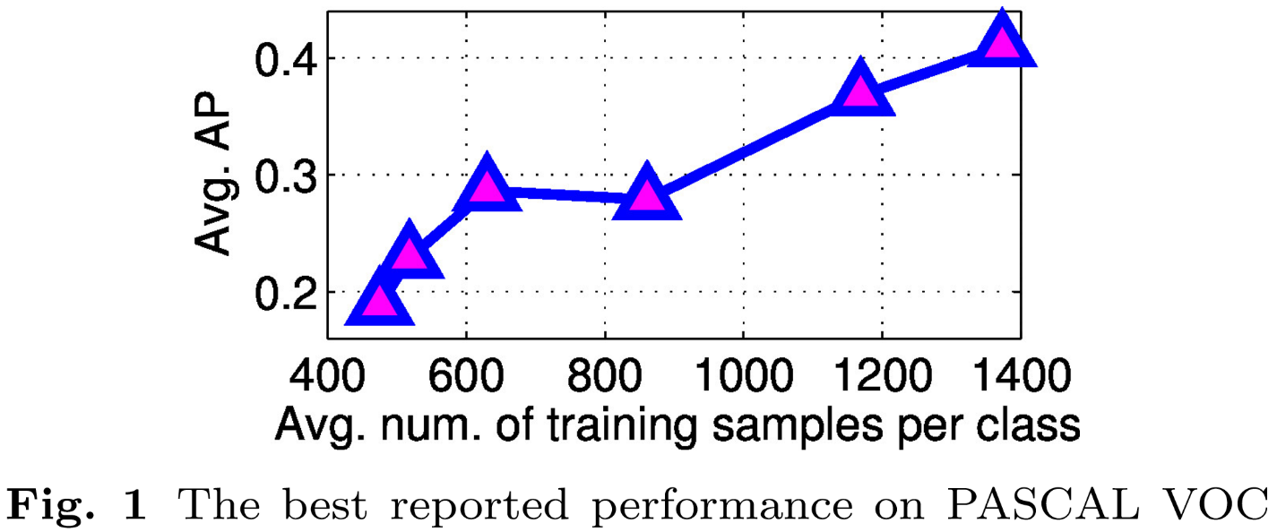

Labeled Data is Important
$$(x_{1},y_{1})$$
$$(x_{2},y_{2})$$
$$⋯$$
$$(x_{n},y_{m})$$
labeled
training data
[Zhu et al., BMVC’12]

Slide 4
Labeled Data is Rare
Labeled data volume << unlabeled data volume
< 10% users offer feedbacks for items they bought
<1.2% of proteins have known structures
< 0.01% of galaxies in SDSS have consensus type labels
< 0.0001% of web pages have topic labels
< 0.0001% of financial transactions labeled w.r.t. fraudulence
<< E-10% of Internet sessions are labeled as to fraudulence
[Carbonell et al., Active and Proactive Machine Learning]
Maybe we need to label more data. Yet ➔

Slide 5
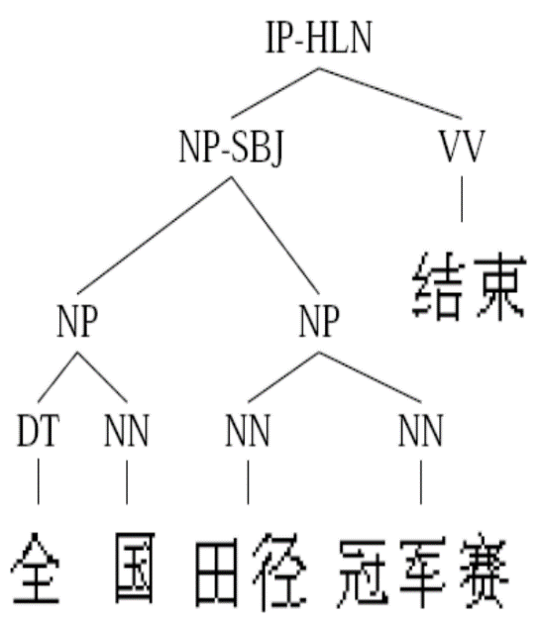

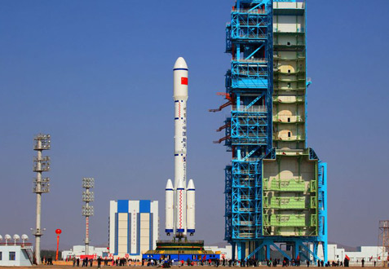
Labeled Data is Expensive
2 years for 4000 sentences in Penn Chinese Treebank
time consuming
only experts can provide accurate annotations
high expertise
special devices are required to get the correct label
enormous expense
[Zhu, 2005; Settles, 2012]

Slide 6
Can we learn with fewer labeled data?
Active Learning

Slide 7
Active Learning
query some labels
labeled data
oracle
(annotator)
train
model
unlabeled data
Goal: train an effective model with least labeling cost

Slide 8
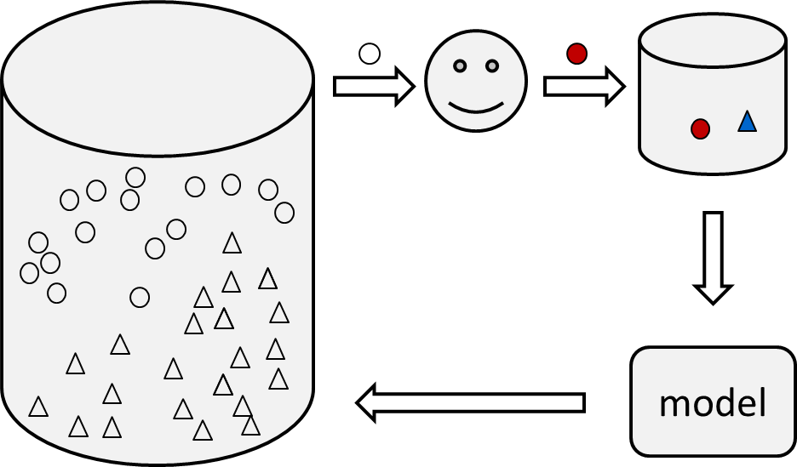
Key Issues in Active Learning
①
②
Selection Criterion
Which instances to select?
Query Type
What information to query?
Imperfect Annotator
How to deal with noisy information?
Complex Tasks
How to handle huge data and complex model?
③
④

Slide 9
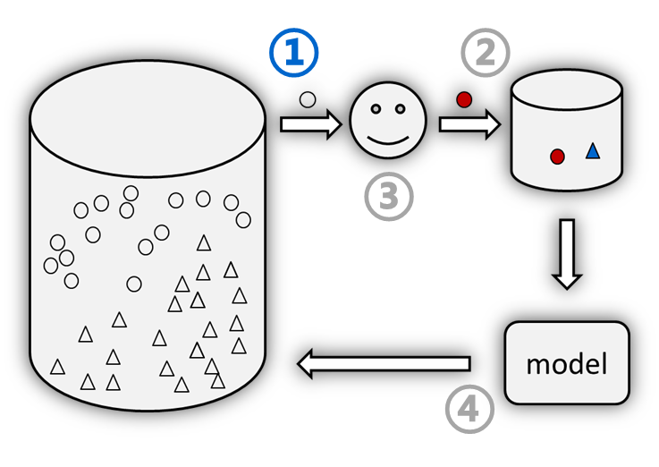
Selection Criterion
Which instances to select?
Single criterion may lead to sample bias
Our Studies
Query Informative and representative examples [PAMI’14, NIPS’10, FCS’16]
Systematically estimate informativeness and representativeness
Tradeoff between learning utility and learning difficulty [AAAI’19a]
Select instances that have high utility and are easy to utilize for the current model
Sample based on diversity and uncertainty [ICDM’13, TCBB’19, AAAI’20a]
Emphasize diversity among the selected batch of uncertain examples

Slide 10
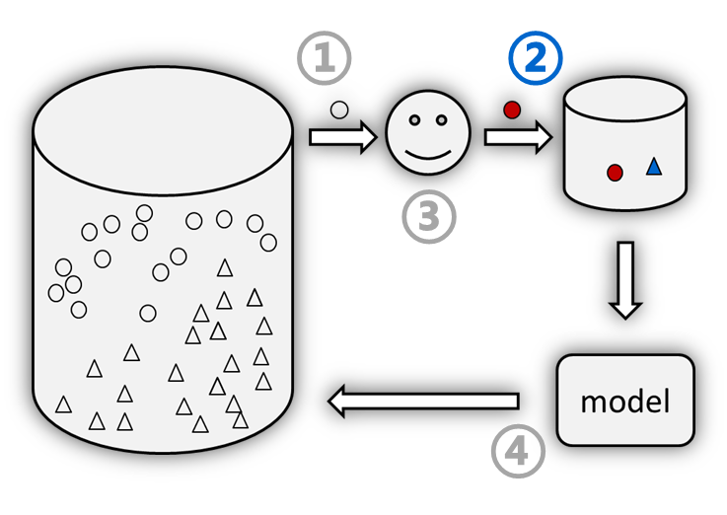
Query Type
What information to query?
Querying labels is not always the best way
Our Studies
Query relevance ordering of labels [IJCAI’15, PR’18]
Actively select instance and label pairs to query their relevance ordering
Query missing feature values [KDD’18a, IJCAI’19]
Query the entries that are useful for recovering other missing values
Query cost-sensitive label correlations [IJCAI’18, SDM’19, KDD’12]
Exploit the hierarchical correlations among multiple labels

Slide 11
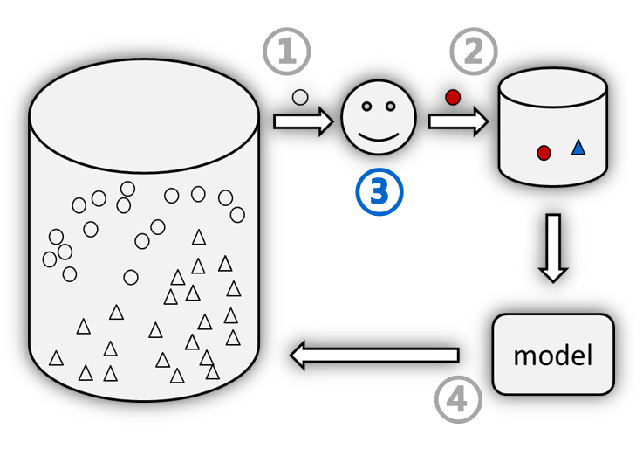
Imperfect Annotator
How to deal with noisy information?
Less robust to low-quality annotations
Our Studies
Transfer information queried from other domains [IJCAI’16]
Simultaneously perform active querying and transfer
Active query under crowdsourcing scenario [IJCAI’17]
There are multiple noisy and diverse annotators providing labels
Learn from noisy label set with partial labels [AAAI’18, AAAI’20b]
Instances are annotated with a candidate set of partial labels

Slide 12
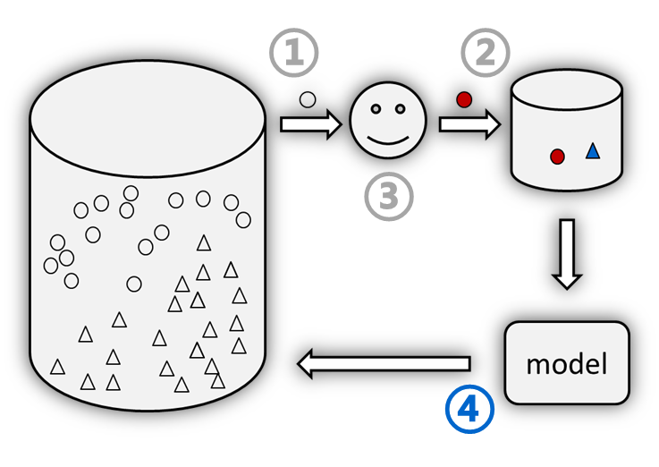
Complex Tasks
How to handle huge data and complex model?
Inefficient to scan the data and update the model
Our Studies
Learn from multi-instance multi-label data [PAMI’19, IJCAI’17]
Actively query precise information with lower cost
Active query for deep neural networks [KDD’18b, KDD’19]
Select the instances that are most helpful for improving the representation
Active query from dynamic environments with open label set [AAAI’19b]
Select instances that are useful for detecting novel classes

Slide 13
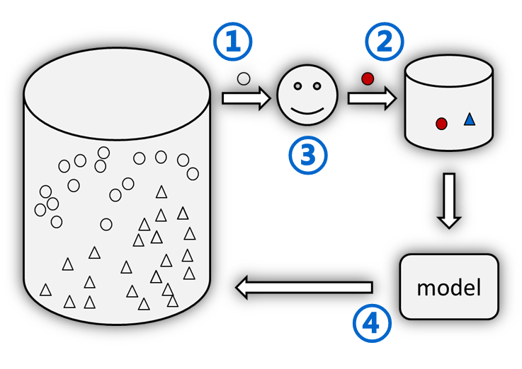
Our Recent Studies in Active Learning
Selection Criterion
Informative & representative [PAMI’14, NIPS’10 FCS’16]
Learning utility & difficulty [AAAI’19a]
Diversity & uncertainty [ICDM’13, TCBB’19, AAAI’20a]
Query Type
Query missing features [KDD’18a, IJCAI’19]
Query relevance ordering [IJCAI’15, PR’18]
Query label correlations [IJCAI’18, SDM’19, KDD’12]
Imperfect Annotator
Transfer from other domains [IJCAI’16]
Query from crowdsourcing [IJCAI’17]
Learn from partial label set [AAAI’18, AAAI’20b]
Complex Tasks
Active learning for MIML [PAMI’19, IJCAI’17]
Active adaptation for deep models [KDD’18b, KDD’19]
Active query for open set learning [AAAI’19b]

Slide 14



Application Examples of AL
Video Recommendation
Aero-Engine Performance Prediction
News Classification

Slide 15
Application Examples of AL
Video Recommendation
Aero-Engine Performance Prediction
News Classification

Slide 16
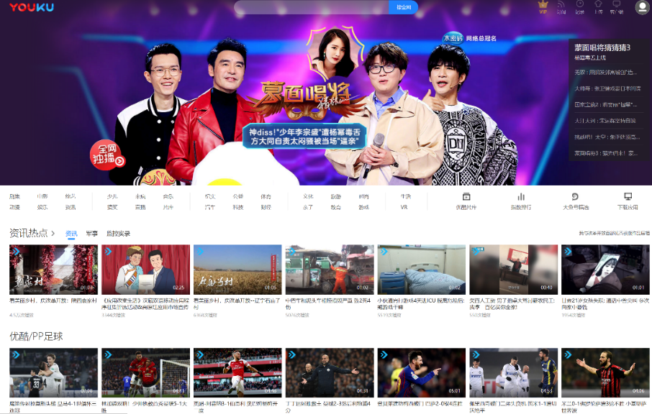


Video Recommendation
Video recommender system plays an important role
Personalized recommendation
Huge Video Corpus
Millions of Users

Slide 17



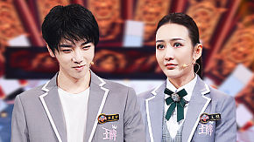




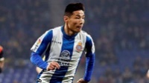


Video Recommendation
Collaborative filtering
Similar users share similar interests
Cold start problem
Content based filtering
A binary classification problem
Large training set needed
…
…
+1
…
…
-1
…
…
-1
…
…
+1
…
…
-1

Slide 18
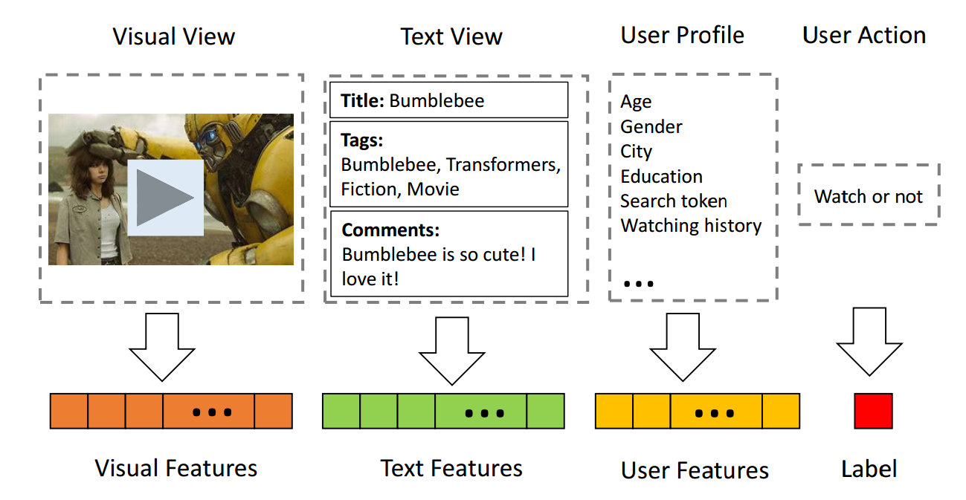
Multi-View Representation
A prediction model based on text features

Slide 19

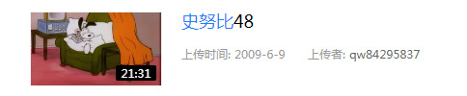


Low-Quality Text Data
Low-quality text data hurts the recommendation performance
Expected
Common Case

Slide 20
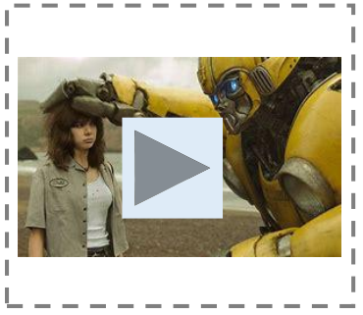
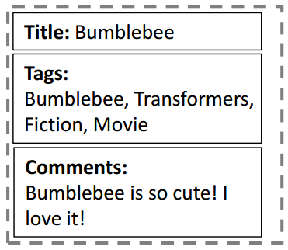
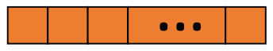
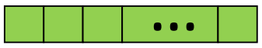
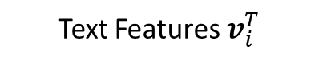
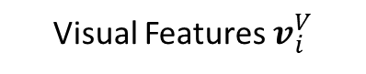
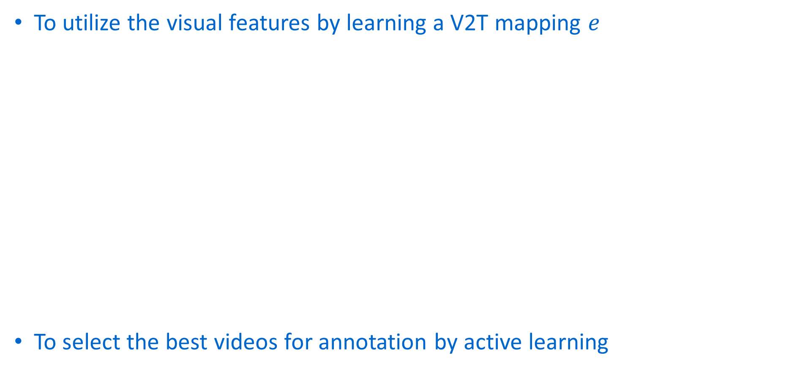

Motivation
To utilize the visual features by learning a V2T mapping $e$
To select the best videos for annotation by active learning
Visual View
Text View
No Human Labor Cost
A mapping function $e$
High Annotation Cost
Visual Features $v_{i}^{V}$
Text Features $v_{i}^{T}$

Slide 21
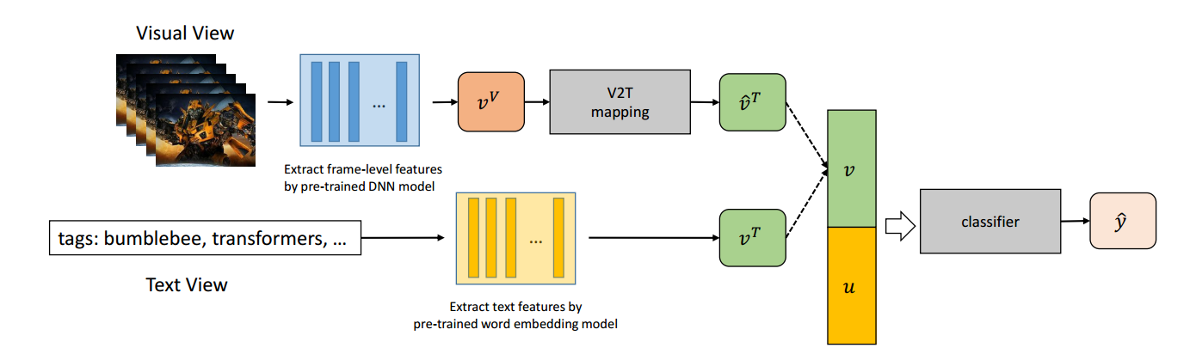
Visual to Text Mapping

Slide 22
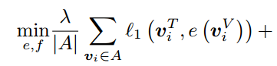
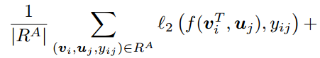
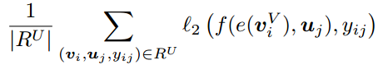
Visual to Text Mapping
Reconstruction Error
Classification Loss

Slide 23
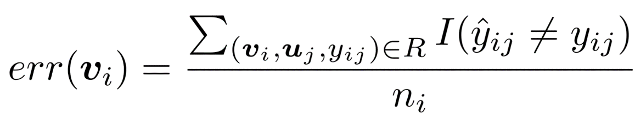
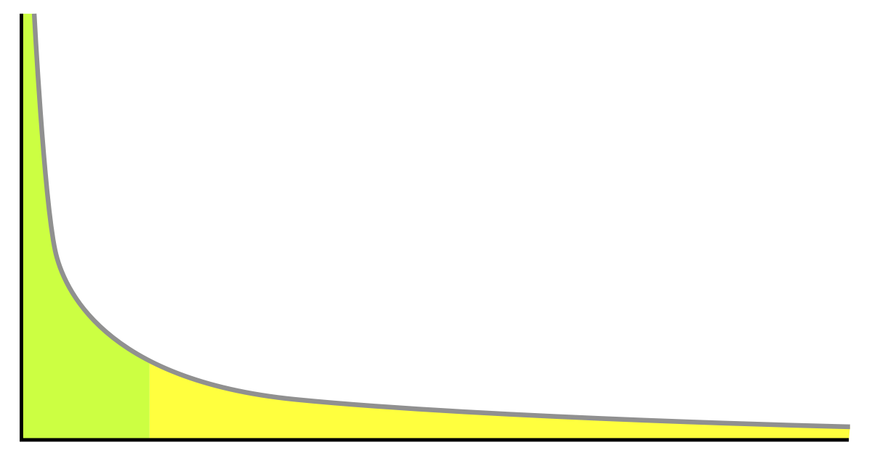
Active Selection
Active query for inconsistent and frequent videos
Inconsistency: error rate of the predictions over $v_{i}$
Frequency: videos has different popularities.
frequency
videos ranked by popularity

Slide 24
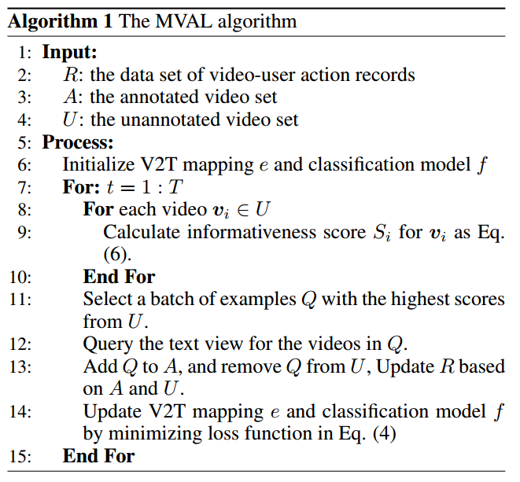
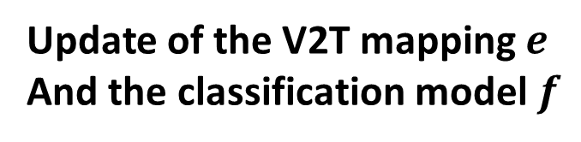
Multi-View Active Learning
Initialization
Active Selection
Update of the V2T mapping $e$
And the classification model $f$

Slide 25
Experiments on Youku Dataset
Youku Dataset
243,219 examples from Blooper, Highlight, Trailer
Visual view: 1-frame-per-second with Inception-v3 ->PCA(2048) -> average pooling
Text view: tags -> word embedding
Baselines:
Random.
Frequency: Select most frequent videos.
MVAL-uncertainty: Select videos with largest average uncertainty.
MVAL: The proposed method.

Slide 26
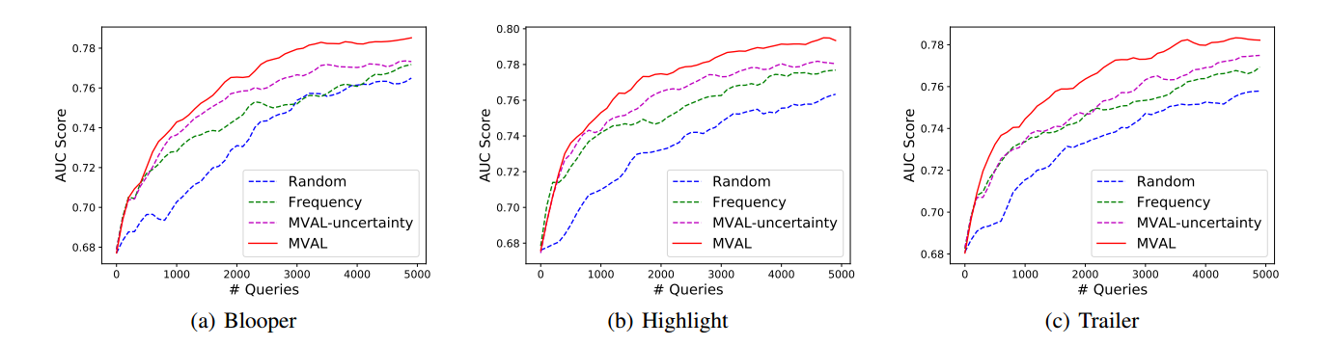
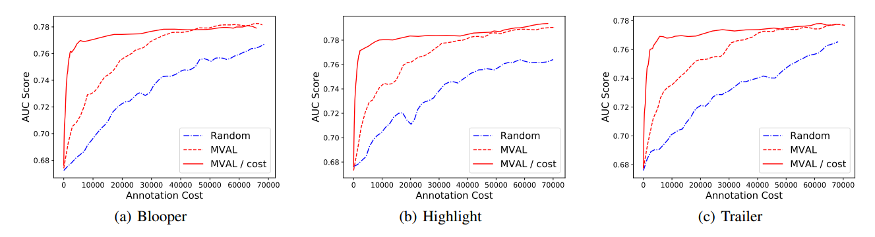
Experiments on Youku Dataset

Slide 27
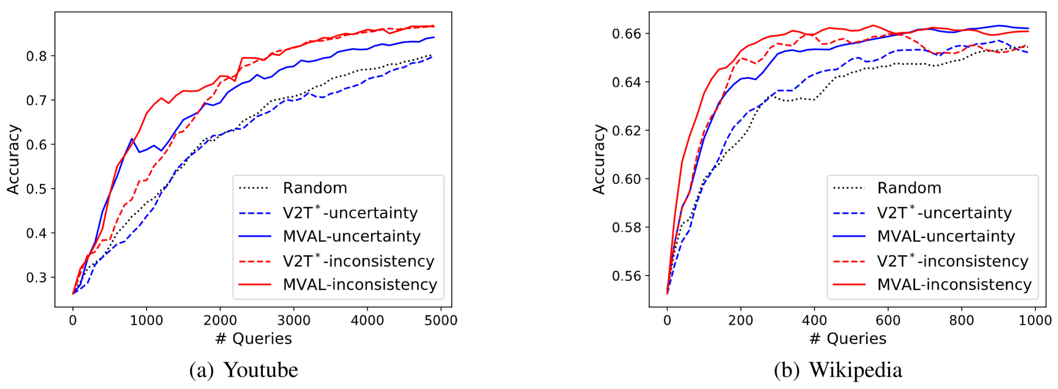
Experiments on Public Datasets

Slide 28
Application Examples of AL
Video Recommendation
Aero-Engine Performance Prediction
News Classification

Slide 29
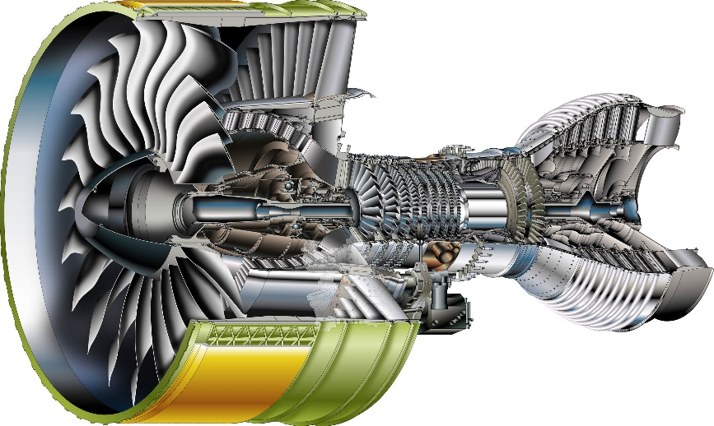
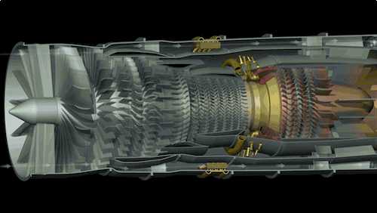
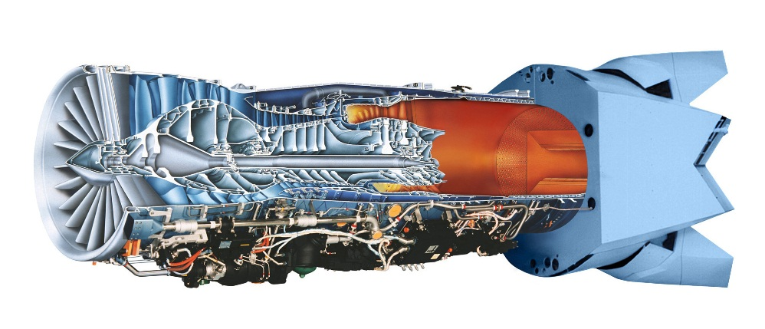
Aero-Engine
Aero-Engine: the Pearl of the crown in manufacturing industry

Slide 30
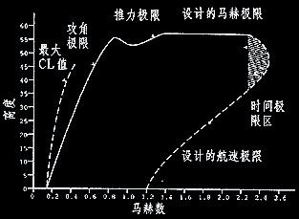
Variable Cycle Engine
Traditional Engine: works in a fixed mode
The Variable Cycle Engine can alternate between different modes
Works efficiently under mixed conditions, such as subsonic, transonic and supersonic
Minimum 25% of fuel saving

Slide 31
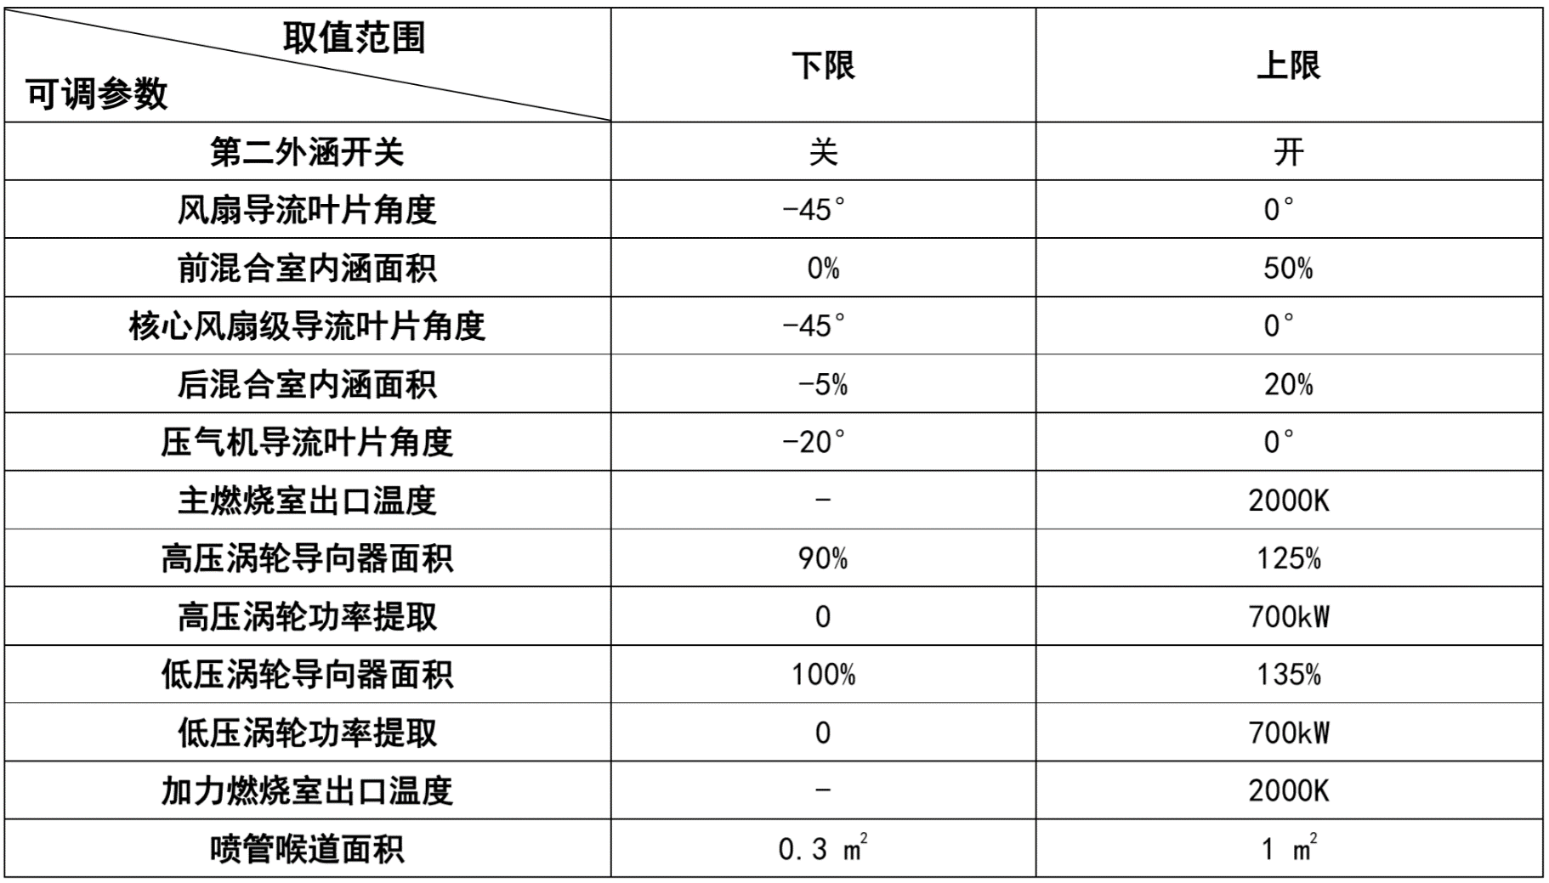
Variable Cycle Engine
Accurate performance prediction is needed for engine mode adaptation
The performance estimation: thrust and fuel consumption
The variables decide the engine performance
Difficult to record
Very limited data with serious feature missing

Slide 32
How to deal with feature missing?
Learning from missing data?
Serious missing leads to poor performance
Querying all missing entries?
High cost of feature acquisition
Not necessary for redundant information
Matrix completion?
Requires sufficient observed entries to recover the missing ones
Can we achieve effective prediction with least feature acquisition cost?

Slide 33
Motivation
SMC: Supervised Matrix Completion
Exploit the label information
Trace-norm for low-rank assumption
AFA: Active Feature Acquisition
Minimize the feature acquisition cost
Contribute to both recovering missing entries and classification
AFA
SMC
model
incomplete data
completed data

Slide 34

Matrix Completion
Traditional matrix completion methods
Low reconstruction error on observed entries
Low-rank assumption for recovering missing entries
Does not consider the supervised information
Will the recovered entries help the prediction model?
11 | 8 |  |  | 2
 | 12 | 5 | 12
1 |  | 2 |  | 3
2 | 77 |  | 83
 | 12 |  | 55 | 12
11 | 8 | 4 | 5 | 2
20 | 12 | 5 | 12 | 3
1 | 45 | 2 | 54 | 3
2 | 77 | 23 | 83 | 18
34 | 12 | 99 | 55 | 12
Matrix Completion

Slide 35
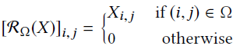
Supervised Matrix Completion
Supervised matrix completion
Jointly optimize the missing entries and the prediction model
Labels guide the matrix completion
Recovered values contribute the prediction
Recovery error on observed entries
Trace-norm for low-rank
Prediction loss

Slide 36
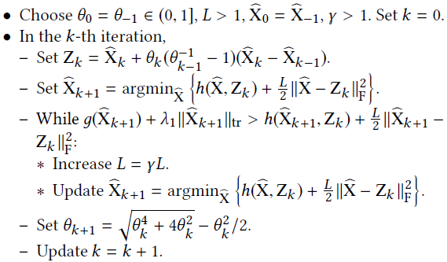
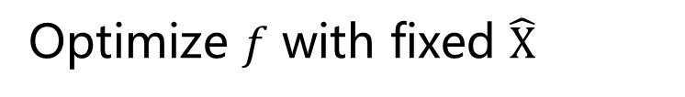
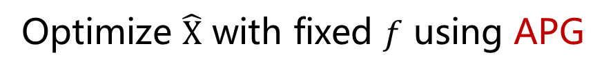
Supervised Matrix Completion
An alternating optimization strategy
Accelerated proximal gradient
repeat until convergence {
Optimize $\hat{X}$ with fixed $f$ using APG
Optimize $f$ with fixed $\hat{X}$
}

Slide 37
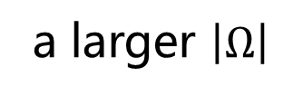
Supervised Matrix Completion
A theoretic bound on the recovery error
a smaller upper bound
active strategies
to reduce cost
Active Feature Acquisition
a larger $\left|Ω\right|$
feature acquisition

Slide 38
Active Feature Acquisition
Active feature acquisition
Query the ground-truth values for most important missing entries
Reduce the feature acquisition cost
Active feature acquisition
classification
model
incomplete data
completed data

Slide 39
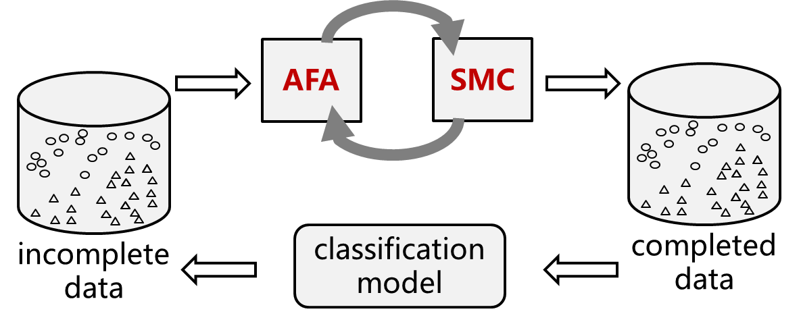

Active Feature Acquisition
Which entries are most important?
Useful for recovering missing entries
Useful for the model training
A variance-based criterion for active selection
Informativeness
recovered value at $t$-th iteration

Slide 40
Acquisition Cost Varies
Acquisition cost varies among features
Not necessarily proportional to the importance

Slide 41
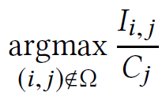
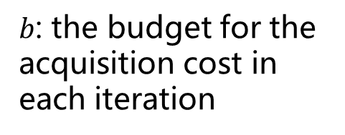
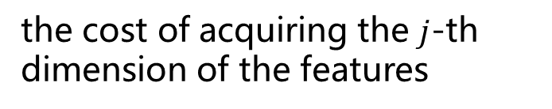
Cost-aware active selection
Balance between informativeness and cost
A naïve solution
A bi-objective optimization solution
the cost of acquiring the $j$-th dimension of the features
$b$: the budget for the acquisition cost in each iteration
total acquisition cost for a batch

Slide 42
Experiments
The proposed method is effective both for matrix completion and prediction

Slide 43

Experiments
The varaince-based selection reduces the acquisition cost

Slide 44
Experiments
More results
Bi-objective optimization is effective for cost-aware selection
Variance of recent iterations reflects the informativeness
[Xie et al., KDD 2018]

Slide 45
Application Examples of AL
Video Recommendation
Aero-Engine Performance Prediction
News Classification

Slide 46


News Classification
News topic classification
high-quality labels required to train effective models
A huge set of unlabeled data (grows every day)
A large set of candidate categories
Time-consuming to read the news
Even impossible to scan the unlabeled pool

Slide 47
Traditional Active Learning
Design a criterion to estimate the utility
calculate the utility for each instance
Select the best one with largest utility
query the labels
labeled data
Select
oracle
(annotator)
train
model
unlabeled data

Slide 48
Active Learning with Query Generation
Design the objective of target instances
Directly generate the instances for query
Does not rely on the size of unlabeled data
query the labels
labeled data
Generate
oracle
(annotator)
train
model
unlabeled data

Slide 49






Query Generation
Generate a batch of $b$ instances at each iteration: $\left\{x_{1},x_{2},…,x_{b}\right\}$
Uncertainty: instances will be close to the decision boundary
Diversity: diversely distributed along the decision boundary
Representative: have a similar distribution with observed data

Slide 50


Query Generation
The final objective function
News summarization: approximation with a few summary words
Annotators may decide the label by reading only the summary words

Slide 51


Visualization of Generated Instances

Slide 52


Experimental Results

Slide 53

Examples of Summary Words

Slide 54


Summary
Active Learning:
train effective models with lower labeling cost
Key issues in active learning:
Selection Criterion
Which instance to select?
Query Type
What information to query?
Imperfect Annotator
How to deal with noisy information
Complex Tasks
How to handle huge data and complex model
Application examples of AL:
Video Recommendation
Aero-Engine Performance Prediction
News Classification

Slide 55

ALiPy: A python toolbox for active learning
ALiPy : Active Learning in Python
https://github.com/NUAA-AL/alipy

Slide 56
Thank You !
黄圣君
huangsj@nuaa.edu.cn
http://parnec.nuaa.edu.cn/huangsj

